Slide 1
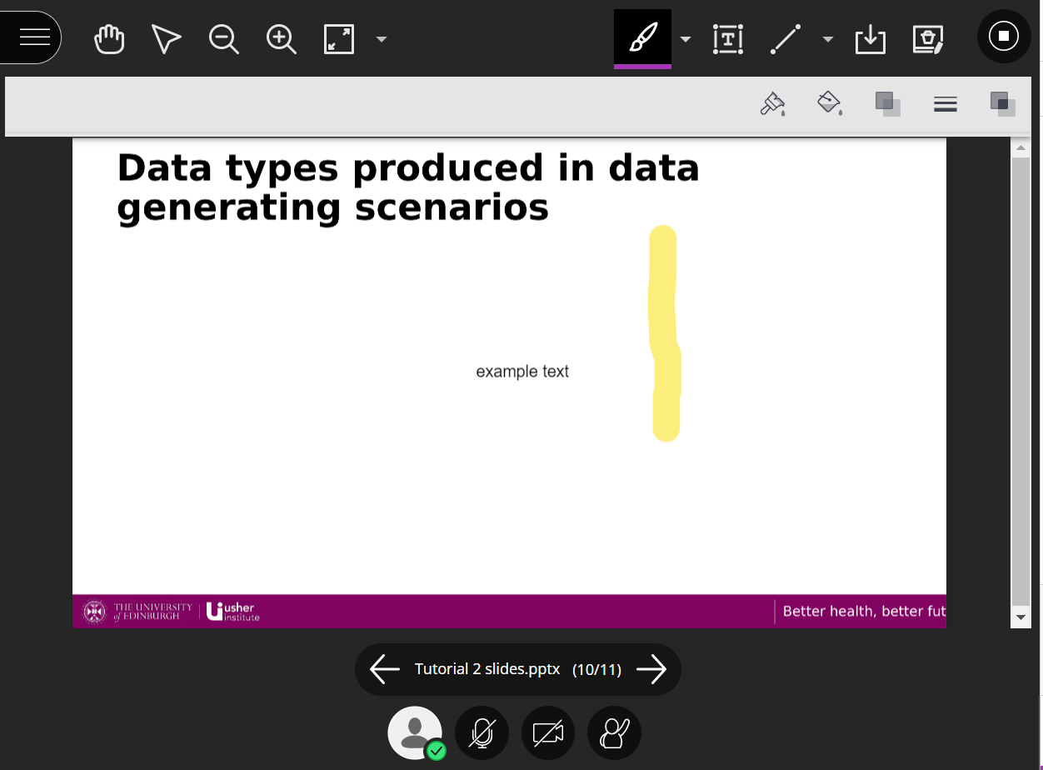
Delete annotations
(be careful!)
Select/
Move
annotation
items
Text box tool
Visible cursor
Pen tool
Download slides with
Annotations
Move between slides

Slide 2
Data types produced in data generating scenarios
Emergency service call outs and transfers (e.g., ambulance)
Hospital waiting times for non-elective surgeries
Smoking behaviours in the community
At-home carers in a local council area (local region)
Any other health and social care situation you can think of!

Slide 3
Data types produced in data generating scenarios
35 min: Discuss the data generated in your selected scenario
What types of data they are
What are the possible range of values
Could the data type vary depending on your analytic use case? If so, how?
Share with everyone what you spoke about in your groups
Be sure to save your document so you can post it on the discussion boards after!

Slide 4
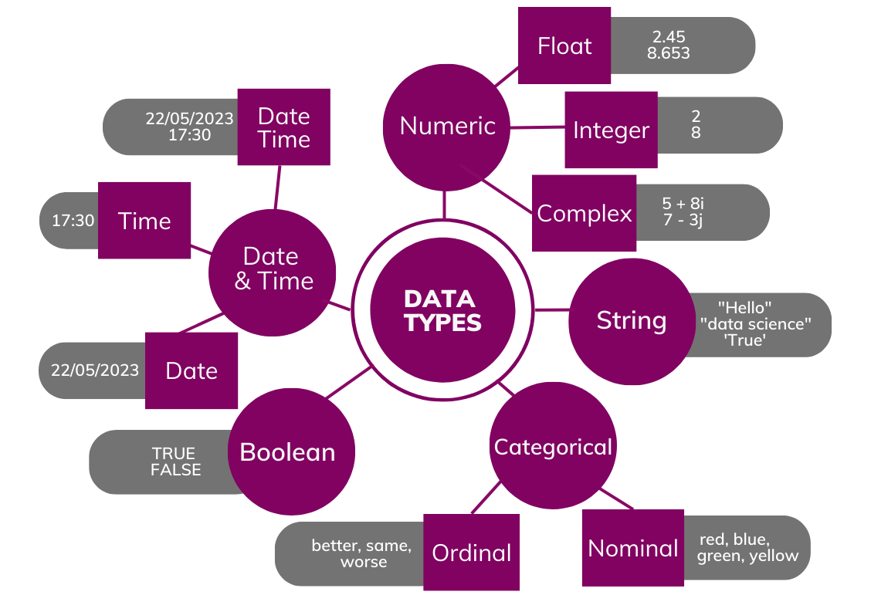

Slide 5
Scenario:

